Slide 1
Introduction to Spring
July 2013

Slide 2
Overview
About Spring
Spring Family
案例分享

Slide 3
About Spring
Spring is the most popular application development framework for enterprise Java
Official Website: http://www.springsource.org/
Source Code base: https://github.com/SpringSource/
Documentation(core): http://static.springsource.org/spring/docs/3.2.x/spring-framework-reference/html/
Books: Spring in Action(4th edition), Spring揭秘, expert one-on-one j2ee design and development
Founder and Author: Rod Johnson, WIKI: http://en.wikipedia.org/wiki/Rod_Johnson_(programmer) Twitter: https://twitter.com/springrod

Slide 4
Spring Family
 | Modern Web | Data access | Integration | Mobile | Social | Security | Cloud
Core | Y | Y | Y | Y | Y | Y | Y
Data |  | Y
Integration |  | Y | Y
Batch |  | Y | Y
Gemfire |  | Y
XD |  | Y | Y
AMQP |  |  | Y
WS |  |  | Y
Web Flow | Y
Social | Y |  |  |  | Y
Mobile | Y |  |  | Y

Slide 5
Spring Family
 | Modern Web | Data access | Integration | Mobile | Social | Security | Cloud
Android |  |  |  | Y
Security |  |  |  |  |  | Y
Security OAuth |  |  |  |  |  | Y

Slide 6
Spring Version
Latest Development release: 4.0.0.M1(future)
Latest GA(General Availability) release: 3.2.4.RELEASE (now)
History versions: 1.x , 2.0.x, 2.5.x, 3.x

Slide 7
Spring 4 goals
First-class support for Java SE 8 based Spring applications(plan 2014/03/18):
  language features such as lambda expressions; APIs such as JSR-310 Date and Time
Configuring and implementing Spring-style applications using Groovy 2:
  Groovy-based bean definitions; Groovy as the language of choice for an entire app
Support for key Java EE 7 technologies(released in 2013.6):
  including JMS 2.0, JPA 2.1, Bean Validation 1.1, Servlet 3.1, and JCache
Enabling WebSocket-style application architectures:
  support for JSR-356 compliant runtimes and related technologies
Fine-grained eventing and messaging within the application:
  building on our existing application event and message listener mechanisms
Pruning and dependency upgrades:
  removing deprecated features; raising minimum dependencies to Java 6+ etc

Slide 8
Spring framework jars
spring-aop(spring aspect oriented programming)
spring-asm( a tool of operating java bytecode , spring3.2.x delete this module, the content is moved to spring-core)
spring-aspect(spring integrate with aspectjrt.jar)
spring-beans(implementation of spring IoC)
spring-context(spring support for j2ee service, such as mail, task scheduling, jndi, ejb, remote call…..)
spring-context-support(enhancement of spring-context ，support for Cache, such as ehcache、jcache, Mail(javamail), Scheduling(quartz), ui(freemarker, velocity))
spring-core(basic classes, all other module should depends on this module)
spring-expression(spring expression)
spring-instrument
Spring-instrument-tomcat(support for tomcat)
Spring-jdbc(support for jdbc)

Slide 9
Spring framework jars
Spring-jms (support for JMS 1.0.2/1.1)
Spring-orm(support for object-relationship DB mapping, it supports iBATIS、JDO、OJB、TopLink)
Spring-oxm(support for Object/XMI mapping)
Spring-test(support for Junit and other test framework)
Spring-transaction(transaction support for JDBC、Hibernate、JDO、JPA)
Spring-web (core classes support for web application)
Spring-webmvc (support JSP& Servlet , Spring MVC)
Spring-webmvc-portlet(support for portlet standard（JSR168/JSR286)
Spring-struts (support for Struts)

Slide 10
Maven for Spring
<dependency>
<groupId>org.springframework</groupId>
<artifactId>spring-context</artifactId>
<version>${spring.version}</version>
<exclusions>
<exclusion>
<groupId>commons-logging</groupId>
<artifactId>commons-logging</artifactId>
</exclusion>
</exclusions>
</dependency>
<dependency>
<groupId>org.springframework</groupId>
<artifactId>spring-core</artifactId>
<version>${spring.version}</version>
</dependency>
<dependency>
<groupId>org.springframework</groupId>
<artifactId>spring-beans</artifactId>
<version>${spring.version}</version>
</dependency>
<dependency>
<groupId>org.springframework</groupId>
<artifactId>spring-aop</artifactId>
<version>${spring.version}</version>
</dependency>

Slide 11
Spring IoC
BeanDefinition
BeanDefinitionParser
BeanDefinitionHolder
BeanDefinitionReader
BeanDefinitionRegistry
BeanComponentDefinition
BeanFactory

Slide 12
BeanDefinition
A BeanDefinition describes a bean instance, which has property values, constructor argument values, and further information supplied by concrete implementations.
Scope (Singleton? Prototype?)
LazyInit (Only applicable to a singleton bean)
DependsOn (bean names that this bean depends on)
Abstract (whether this bean is "abstract", that is, not meant to be instantiated)
Object beanClass (The bean class)

Slide 13
BeanDefinitionHolder
Holder for a BeanDefinition with name and aliases.

Slide 14
BeanFactory
ApplicationContext:
  ClassPathXmlApplicationContext
  FileSystemXmlApplicationContext
  XmlWebApplicationContext
  AnnotationConfigWebApplicationContext(3.0)
  AnnotationConfigApplicationContext(3.0)
BeanFactory:
  DefaultListableBeanFactory: above ApplicationContexts all contains a internal BeanFactory

Slide 15
BeanDefinitionReader
PropertiesBeanDefinitionReader : Bean definition reader for a simple properties format.
XmlBeanDefinitionReader: Bean definition reader for XML bean definitions

Slide 16
BeanComponentDefinition
ComponentDefinition based on a standard BeanDefinition, exposing the given bean, definition as well as inner bean definitions and bean references for the given bean.
It’s subclass of BeanDefinitionHolder

Slide 17
BeanDefinitionRegistry
SubClasses: DefaultListableBeanFactory (BeanFactory)
Methods: registerBeanDefinition

Slide 18
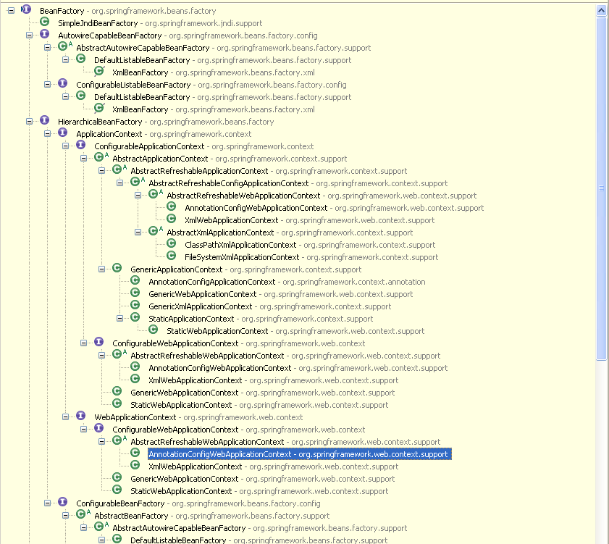
Bean Factory Hierarchy

Slide 19
<Beans> attributes and inner tags
All Beans under this <Beans> definition will apply the rules.
default-lazy-init: default value is false.
default-autowire: no, byName, byType, constructor, autodetect. Default values is no.
default-init-method: init method name for all <bean>s.
default-destory-method: destory method name for all <bean>s.
<description>
<alias>: alias for a certain bean
<import>: import other other configure file
<bean>: bean definition

Slide 20
<Bean> attributes and inner tags
id: unique identifier for the bean in the container.
class: class used.
<constructor-args>: for constructor injection
<property>: for setter injection
depends-on
autowire
dependency-check
lazy-init
parent
abstract
scope
factory-method

Slide 21
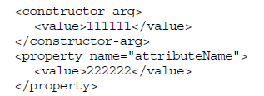
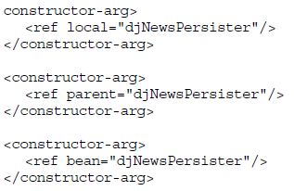
Configuration for <property>,<constructor-arg>
<value>
<ref>
  local: only refer to the “bean” in the same xml
  parent: only refer to the “bean” in the parent container
  bean: best choice.

Slide 22

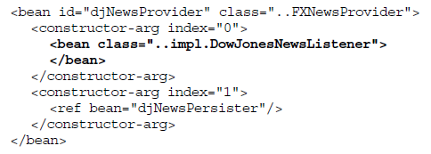
Configuration for <property>,<constructor-arg>
<idref> : inject bean’s name, instead of the reference
Inner <bean>: the bean cannot be referred by other beans.

Slide 23
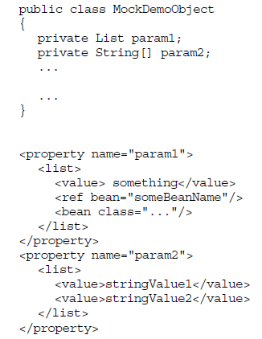
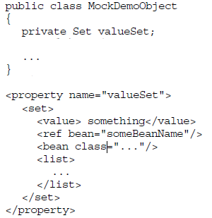
Configuration for <property>,<constructor-arg>
<list>
<set>

Slide 24
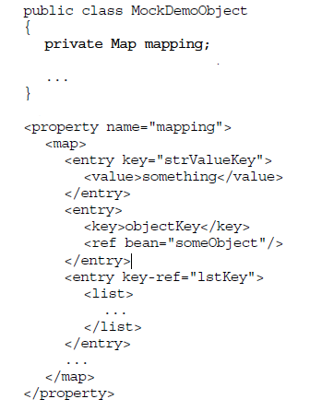
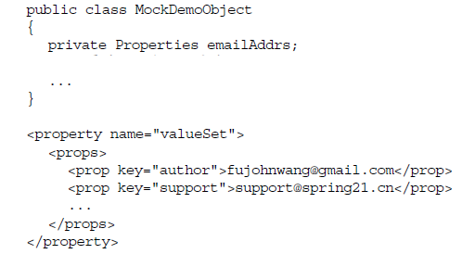
Configuration for <property>,<constructor-arg>
<map>
<props>

Slide 25
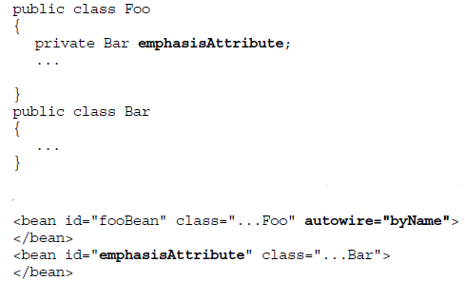
<Bean> attributes and inner tags
depends-on: control loading sequence.
autowire: no(default), byName, byType, construtor, autodetect

Slide 26
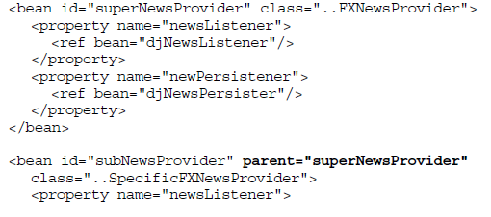
<Bean> attributes and inner tags
lazy-init: lazy initialize bean
parent: inherit configuration

Slide 27
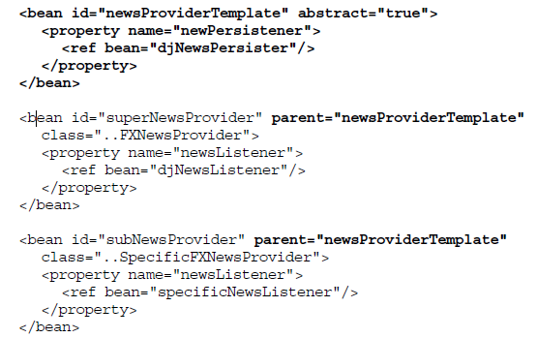
<Bean> attributes and inner tags
abstract: a template bean definition. Container will not instantiate the bean with abstract=“true”

Slide 28
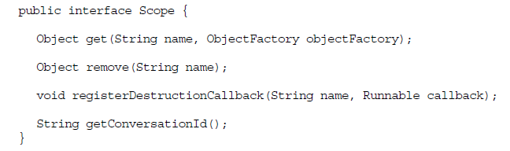
<Bean> attribute Scope
Scope: singleton(default), prototype
Web only(XmlWebApplicationContex): request, session, global session(for portlet). Since Spring 2.0
You can customize your own scope, just as spring-batch define a scope called “step”. Need to implement interface: org.springframework.beans.factory.config.Scope, and use a defined BeanFactoryPostProcessor: org.springframework.beans.factory.config.CustomScopeConfigurer to register the customized scope.
<aop:scoped-proxy/>, you need to add this to let container know when to instantiate or destroy the object has customized scope (except singleton, prototype, others all belongs to customized scope).

Slide 29
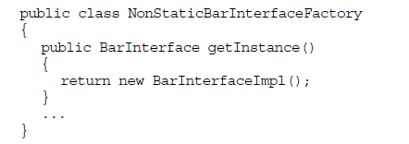
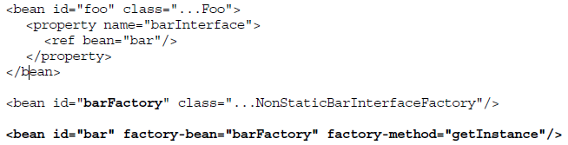
<Bean> attribute factory-bean, factory-method

Slide 30
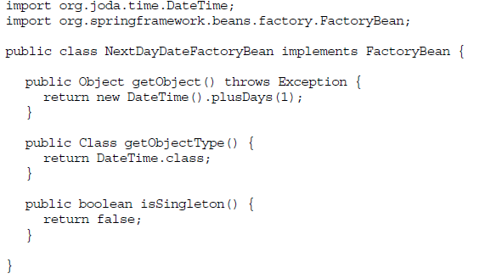
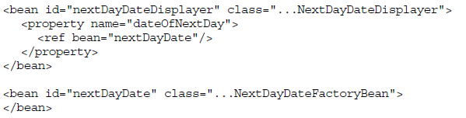

FactoryBean
When the instantiation of a bean is very complex, we need to write java code to do it, we could consider implementing org.springframework.beans.factory.FactoryBean.

Slide 31
<Bean> attribute init-method, destory-method
<bean id=“bean1” class=“….Bean1” init-method=“initMethod” destroy-method=“destoryMethod”>
Interface: InitializingBean,DisposableBean
Annotation: @PostConstruct, @PreDestroy
Sequence:
1. @PostConstruct
2. InitializingBean
3. init-method
4. @PreDestroy
5. DisposableBean
6. destroy-method

Slide 32
Useful XML configuration
<context:annotation-config>: Spring's @Required and @Autowired,@Value as well as JSR 250's @PostConstruct, @PreDestroy and @Resource (if available), JAX-WS's @WebServiceRef (if available), EJB3's @EJB (if available), and JPA's @PersistenceContext and @PersistenceUnit (if available)
<context:component-scan> : includes all annotations mentioned above, it means we could retire <context:annotation-config> ,also support @Component, @Repository, @Service, and @Controller, its attribute: base-package, include-filter, exclude-filter. The schema register several BeanPostProcessors. E.g., AutowiredAnnotationBeanPostProcessor
<context:property-placeholder>: Activates replacement of ${...} placeholders by registering a PropertySourcesPlaceholderConfigurer within the application context
<aop:aspectj-autoproxy >: Enables the use of the @AspectJ style of Spring AOP
<aop:scoped-proxy>: enable self-customized scope.
<aop:config>: traditional AOP configuration by XML.
<tx:advice>: traditional Transaction manage by XML. Need to work with <aop:config>
<tx:annotation-driven>: support @Transactional, 12.5.6 (http://static.springsource.org/spring/docs/3.2.x/spring-framework-reference/html/transaction.html)

Slide 33
Spring AOP

Slide 34
Spring Transcation

